Slide 1
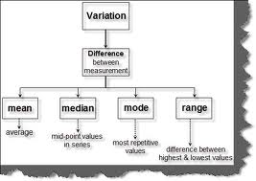
12. Using Basic Descriptive Analysis

Slide 2
To do list
Mid-term question?
PA5: data collection
PA6: data analysis plan

Slide 3
Commonly used Descriptive Analysis
Raw frequency or percent
Measures of central tendency (typical response): used to report a single piece of information that describes the most typical response to a question
Measures of variability (uncertainty): used to reveal the typical difference between the values in a set of values

Slide 4
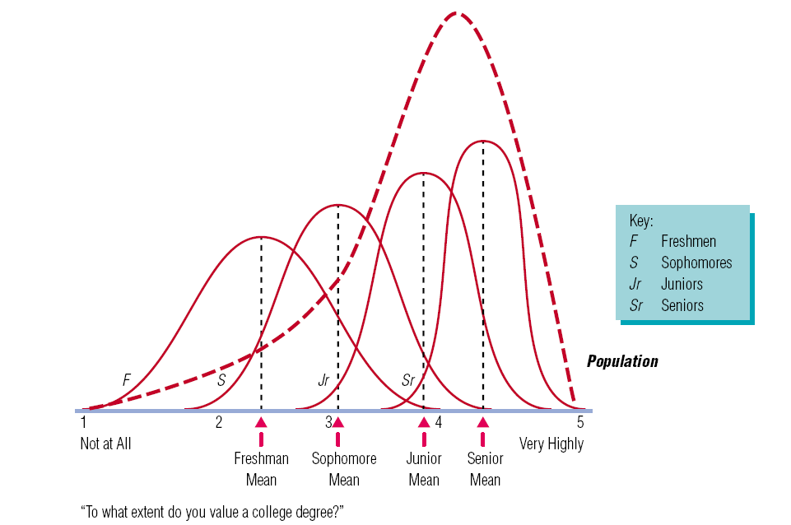
Probability Sampling Methods
Central tendency = the center of the bell shape
Variance is the spread

Slide 5
Measures of Central Tendency
Mean: sometimes referred to as the “arithmetic mean”; the average value characterizing a set of numbers
Mode: the value in a string of numbers that occurs most often
Median: the value whose occurrence lies in the middle of a set of ordered values

Slide 6
Measures of Variability
Frequency distribution reveals the number (percent) of occurrences of each number or set of numbers
Range identifies the maximum and minimum values in a set of numbers
Standard deviation indicates the degree of variation in a way that can be translated
into a bell-shaped curve distribution

Slide 7
iClicker - In Class Exercise
40, 80, 83, 85, 88, 90, 91, 95, 100
Mean
Mode
Median
Mean: 84
Mode:
Median: 88

Slide 8
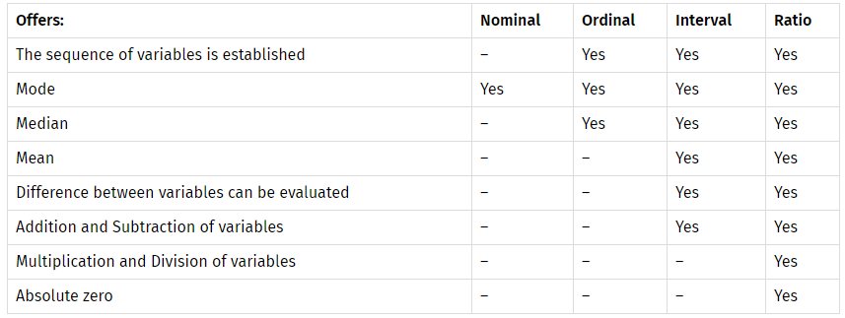
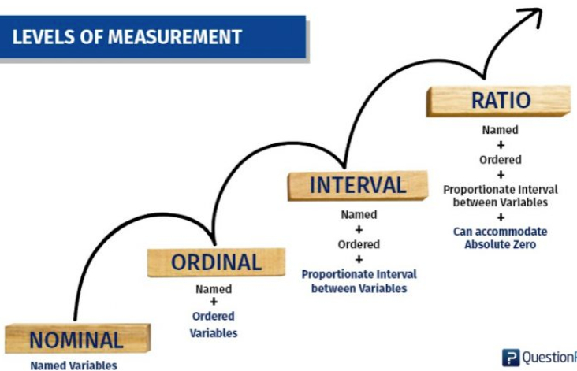
Categorical variable
Continuous variable
Statistical procedure
Mode: categorical and continuous
Mean: only continuous. why?
What’s the average of first place (1), second place (2), third place(3), and other ranks(4)?
Note: the number in the parentheses is your questionnaire response option.
Notes:
Rights reserved: www.questionpro.com

Slide 9
iClicker - Which Measure of Central Tendency (mode or mean) should you use?
Gender of respondent (Male or Female) hint: can you do average gender? how do you calculate average?
Customer Satisfaction (how satisfied are you with the store’s customer service? – use 5 point scale – 1 not satisfied; 5 very satisfied)

Slide 10
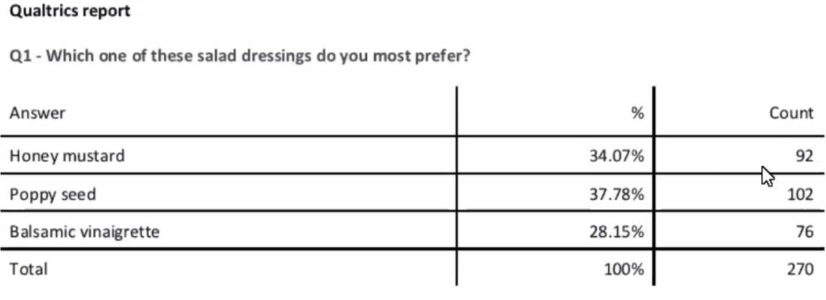
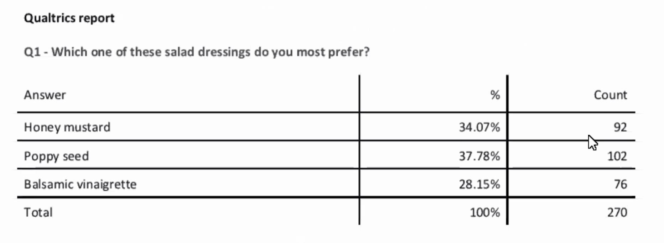

Slide 11
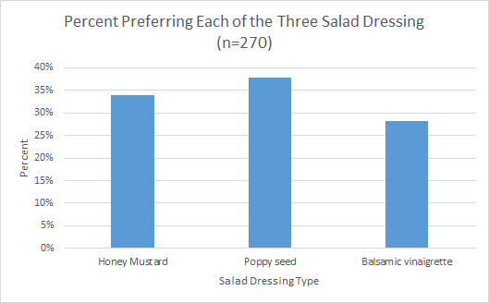

Slide 12
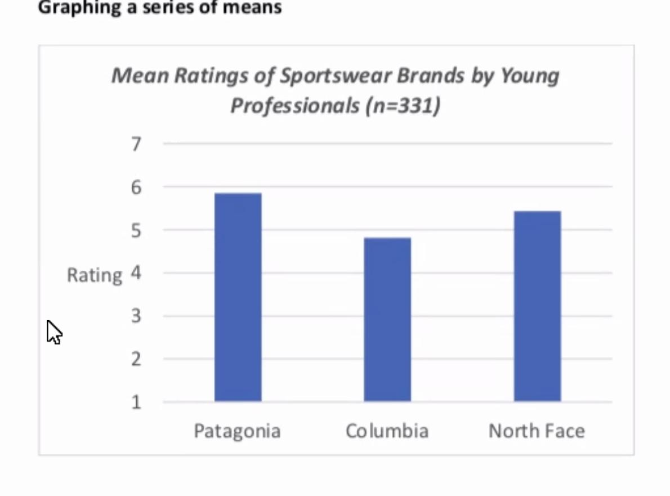

Slide 13
Four level of measurement
Type of Research questions
Descriptive statistics
Data analysis plan

Slide 14
Agenda:
Data analysis plan for your PA6
Practice the data analysis plan using your QQ Worksheet B

Slide 15
Agenda:
To-do: PA6, PA7 (next week)
Difference RQ data visualization
Difference RQ data from Qualtrics
Intermediate descriptive statistics analytics techniques

Slide 16
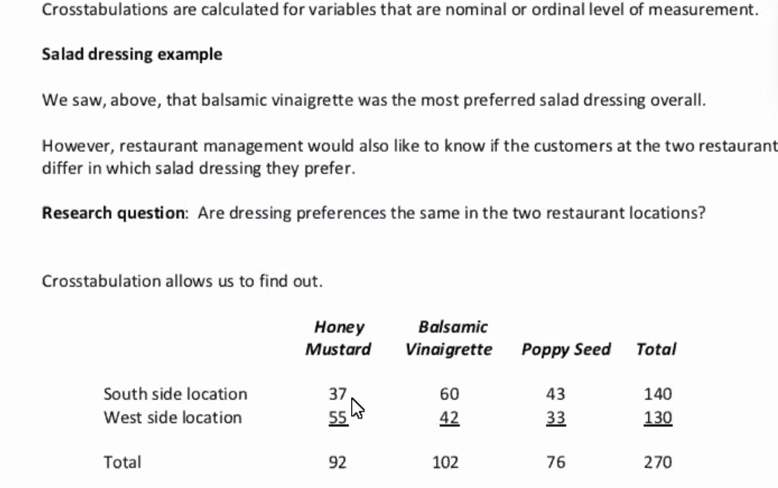

Slide 17
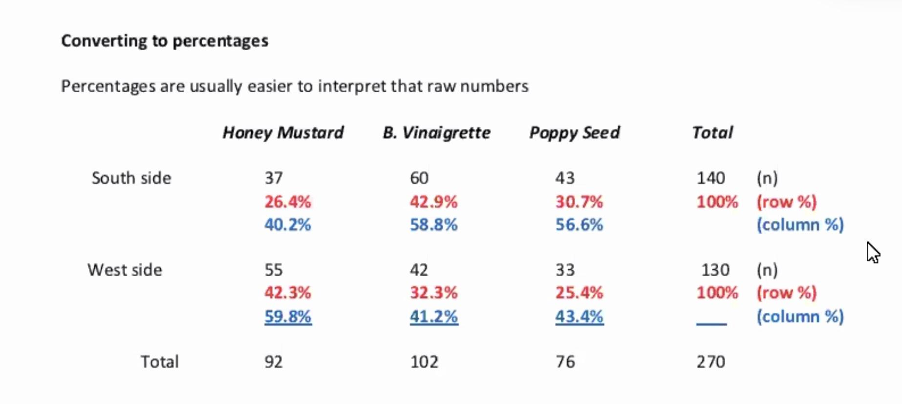

Slide 18
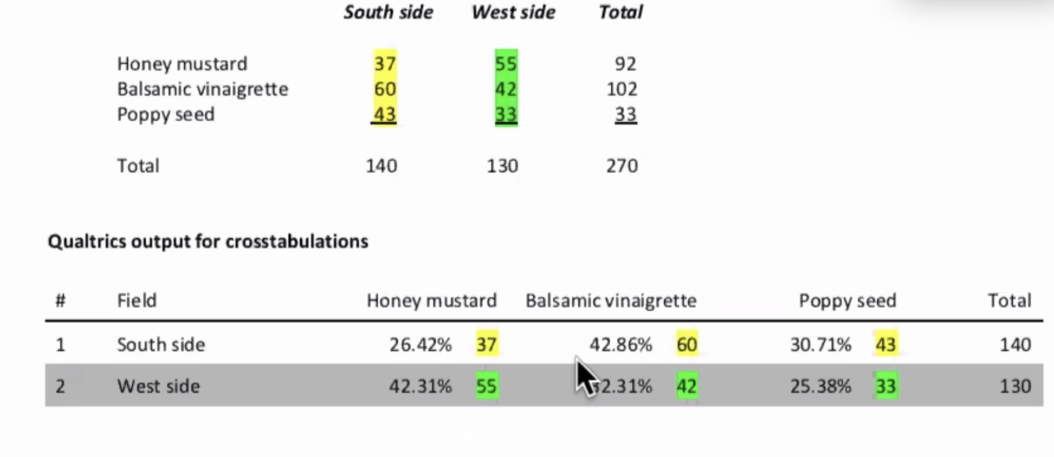

Slide 19
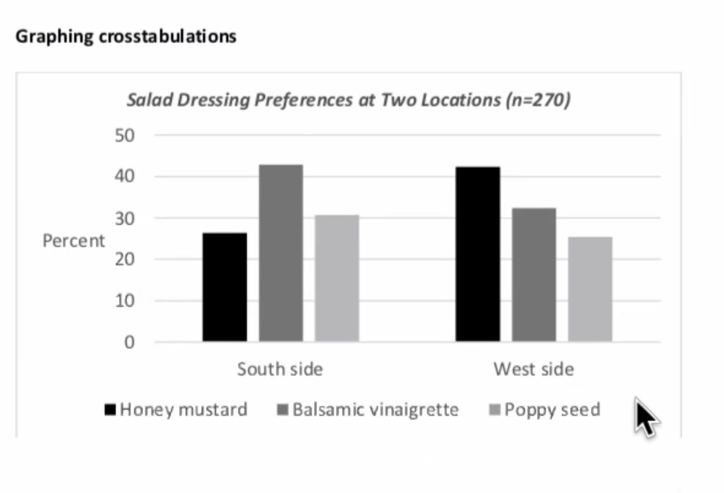

Slide 20
Notes:
http://www.netlogoweb.org/launch#http://www.netlogoweb.org/assets/modelslib/Sample%20Models/Social%20Science/Rumor%20Mill.nlogo

